Slide 1
Term 3 Week 6 Lesson 2
Indicators and pH

Slide 2
Litmus is a mixture of water-soluble dyes extracted from lichens. Litmus is called an acid-base indicator. Litmus turns red in acidic solutions, and blue in basic solutions.
An indicator is used to provide information on the degree of acidity or alkalinity of a solution. Chemists have developed a scale to measure the concentration of acid in a solution known as pH scale.

Slide 3
The pH scale
The term pH stands for ‘hydrogen power’.
Danish biochemist Soren Sorensen devised the scale to make writing the hydrogen ion concentration in solution more manageable.
The pH scale is based on the concentration of hydrogen ions in solution. It provides a measure of the acidity or alkalinity in aqueous solutions.

Slide 4
The pH scale generally ranges from 0 to 14. the lower the pH, the more acidic a solution is; the higher the pH , the more basic the solution is.
Acids have a pH of less than 7, bases have a pH greater than 7, and a substance that has a pH equal to 7 is neutral.
See table C 7.2 in page: 325

Slide 5
There is a relationship between the pH value and the superscript number in the hydrogen ion concentration. They are the same number because pH is based on the hydrogen ion concentration of a solution.
A change in I unit on the pH scale is equivalent to a 10 times change in the hydrogen ion concntration.

Slide 6
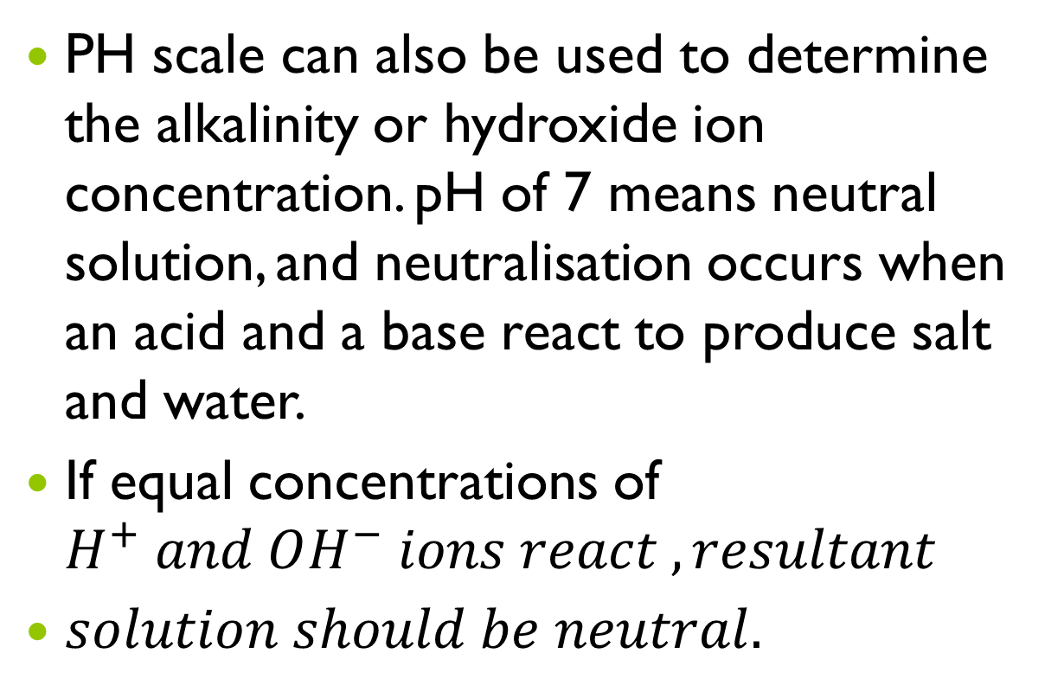
PH scale can also be used to determine the alkalinity or hydroxide ion concentration. pH of 7 means neutral solution, and neutralisation occurs when an acid and a base react to produce salt and water.
If equal concentrations of $H^{+} and OH^{−} ions react , resultant$
$solution should be neutral.$

Slide 7
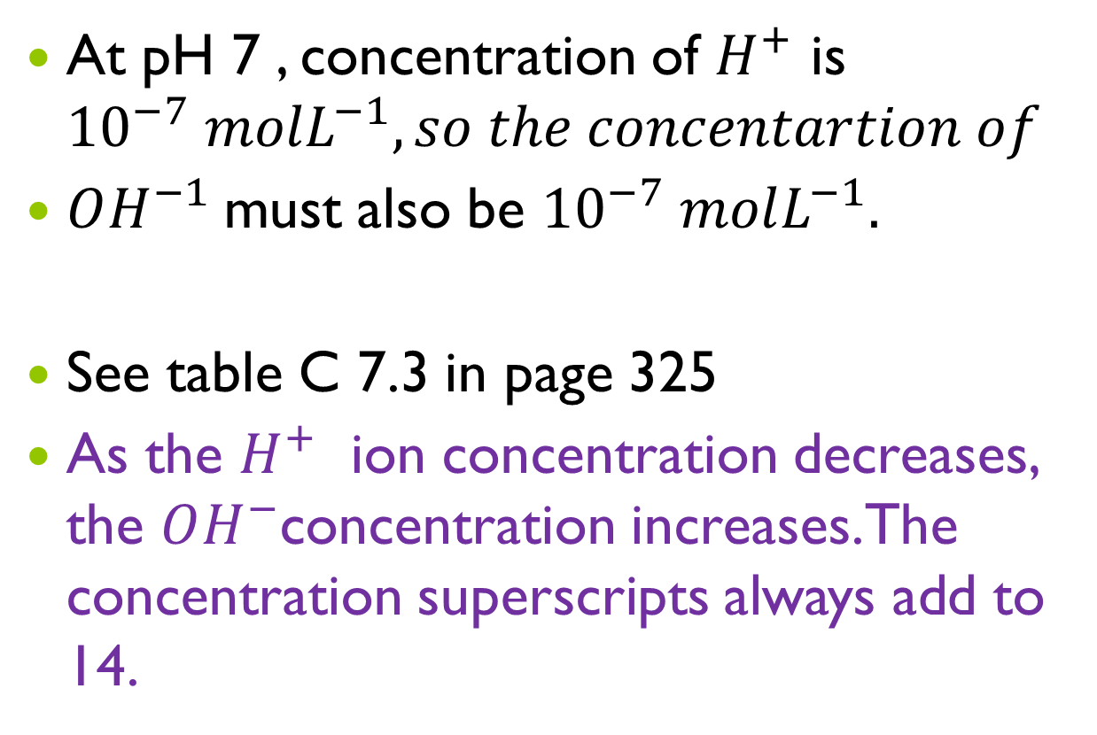
At pH 7 , concentration of $H^{+}$ is ${10}^{−7} molL^{−1}, so the concentartion of$
$OH^{−1}$must also be ${10}^{−7} molL^{−1}.$
See table C 7.3 in page 325
As the $H^{+}$ ion concentration decreases, the $OH^{−}$concentration increases. The concentration superscripts always add to 14.

Slide 8
Measuring pH
Some synthetic indicators are methyl violet, methyl orange, litmus, bromothymol blue and phenolphthalein.
Chemists have developed a universal indicator that produces several colour changes depending on the pH of the solution. It is a mixture of several indicators.

Slide 9
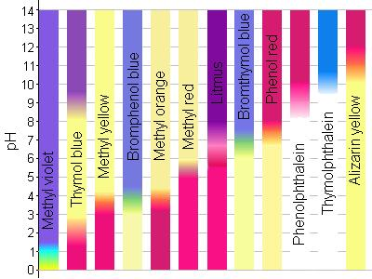

Slide 10
